Slide 1

Addressing Shame

Slide 2

SHAME

Slide 3

“Shame is universal.
We all have it.
The less you talk about it the more you have it.”
Dr. Brené Brown

Slide 4
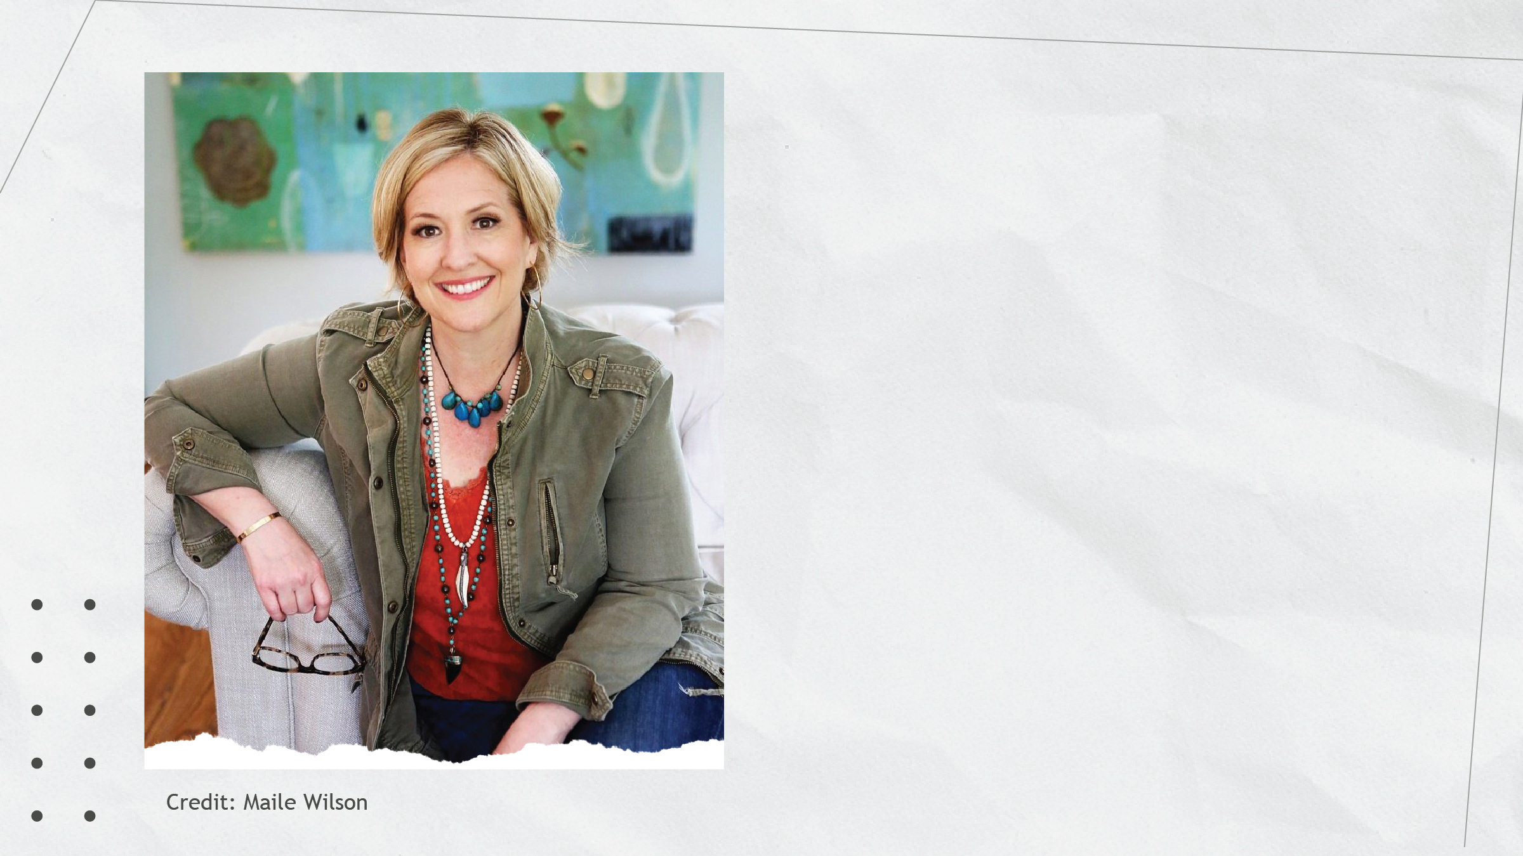

Shame Research
Dr. Brené Brown
University of Houston
Author of Daring Greatly
and Dare to Lead
Shame:
The fear of disconnection

Slide 5

Guilt
I did something bad.
Shame
I am bad.

Slide 6

Shame
Empathy

Slide 7



Gender Differences
Female Shame
Do it all.
Do it perfectly.
Never let them see you sweat.
Conflicting expectations for what I am supposed to be.

Slide 8

Gender Differences
Female Shame
Male Shame
Do it all.
Do it perfectly.
Never let them see you sweat.
Be strong.
Be the hero.
Never be perceived as weak.
Conflicting expectations for what I am supposed to be.
A singular expectation for what I am supposed to be.

Slide 9
Addressing Shame

