Slide 1

An Extravagant Grace

Slide 2

Prayer

Slide 3

An Extravagant Grace
Acts 26:9-22a

Slide 4

In His grace-filled
relating to us, God insists
on dealing with reality.

Slide 5

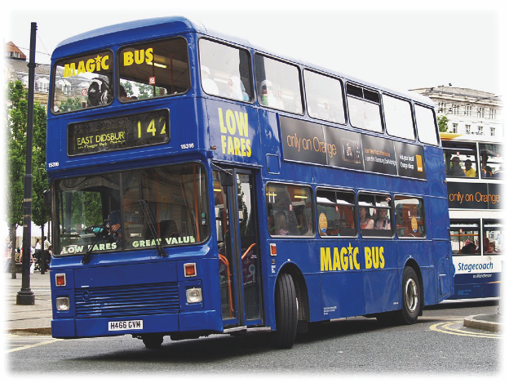

Slide 6


A Divine Disruption
The first movement of grace is to bring us to reality.
We must face our reality.

Slide 7

The Divine Embrace
The next movement of grace is to meet us in our reality.

Slide 8
The Divine Embrace
When we own what we must own, the grace of God moves from our heads to our hearts... and we begin to live life from His embrace.

Slide 9
The Divine Invitation
You have an invitation into “the now” of God’s grace.

Slide 10
The Divine Invitation
From the embrace of your grace, I let go of the past.
From the embrace of your grace, I trust the future to you.

Slide 11

The Divine Invitation
“I have God’s help this very day; and I choose to stand... In the now of His grace.”

Slide 12

Communion

Slide 13
An Extravagant Grace

