Slide 1

Financial Best
Practices Questions

Slide 2

The important and difficult job is never to find the right answer, it is to find the right question.
Peter Drucker, The Practice of Management (1954)

Slide 3
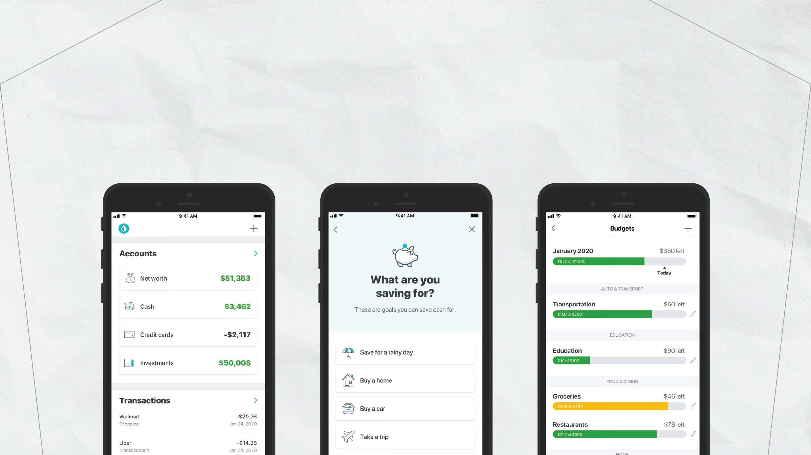
Question #1:
Is my financial life organized and protected?

Slide 4
Question #1:
Is my financial life organized and protected?

Slide 5
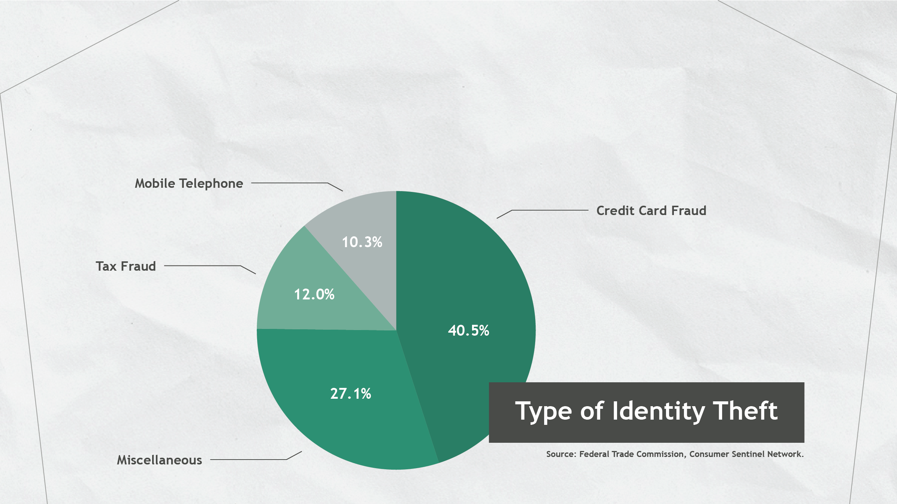
Question #1:
Is my financial life organized and protected?

Slide 6
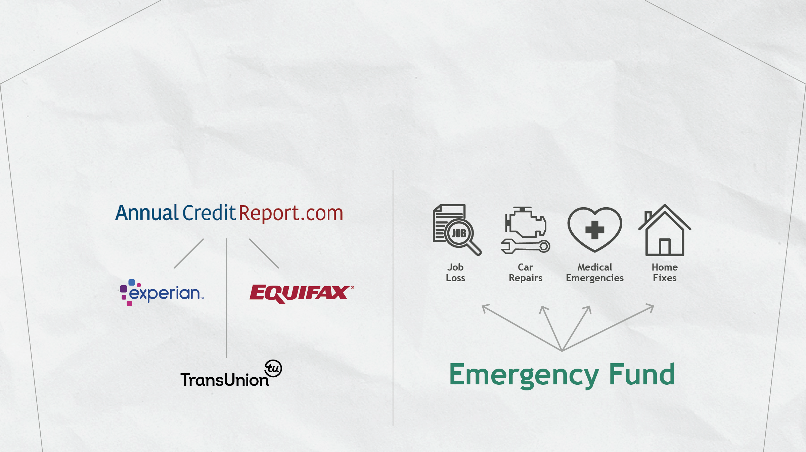
Question #1:
Is my financial life organized and protected?

Slide 7
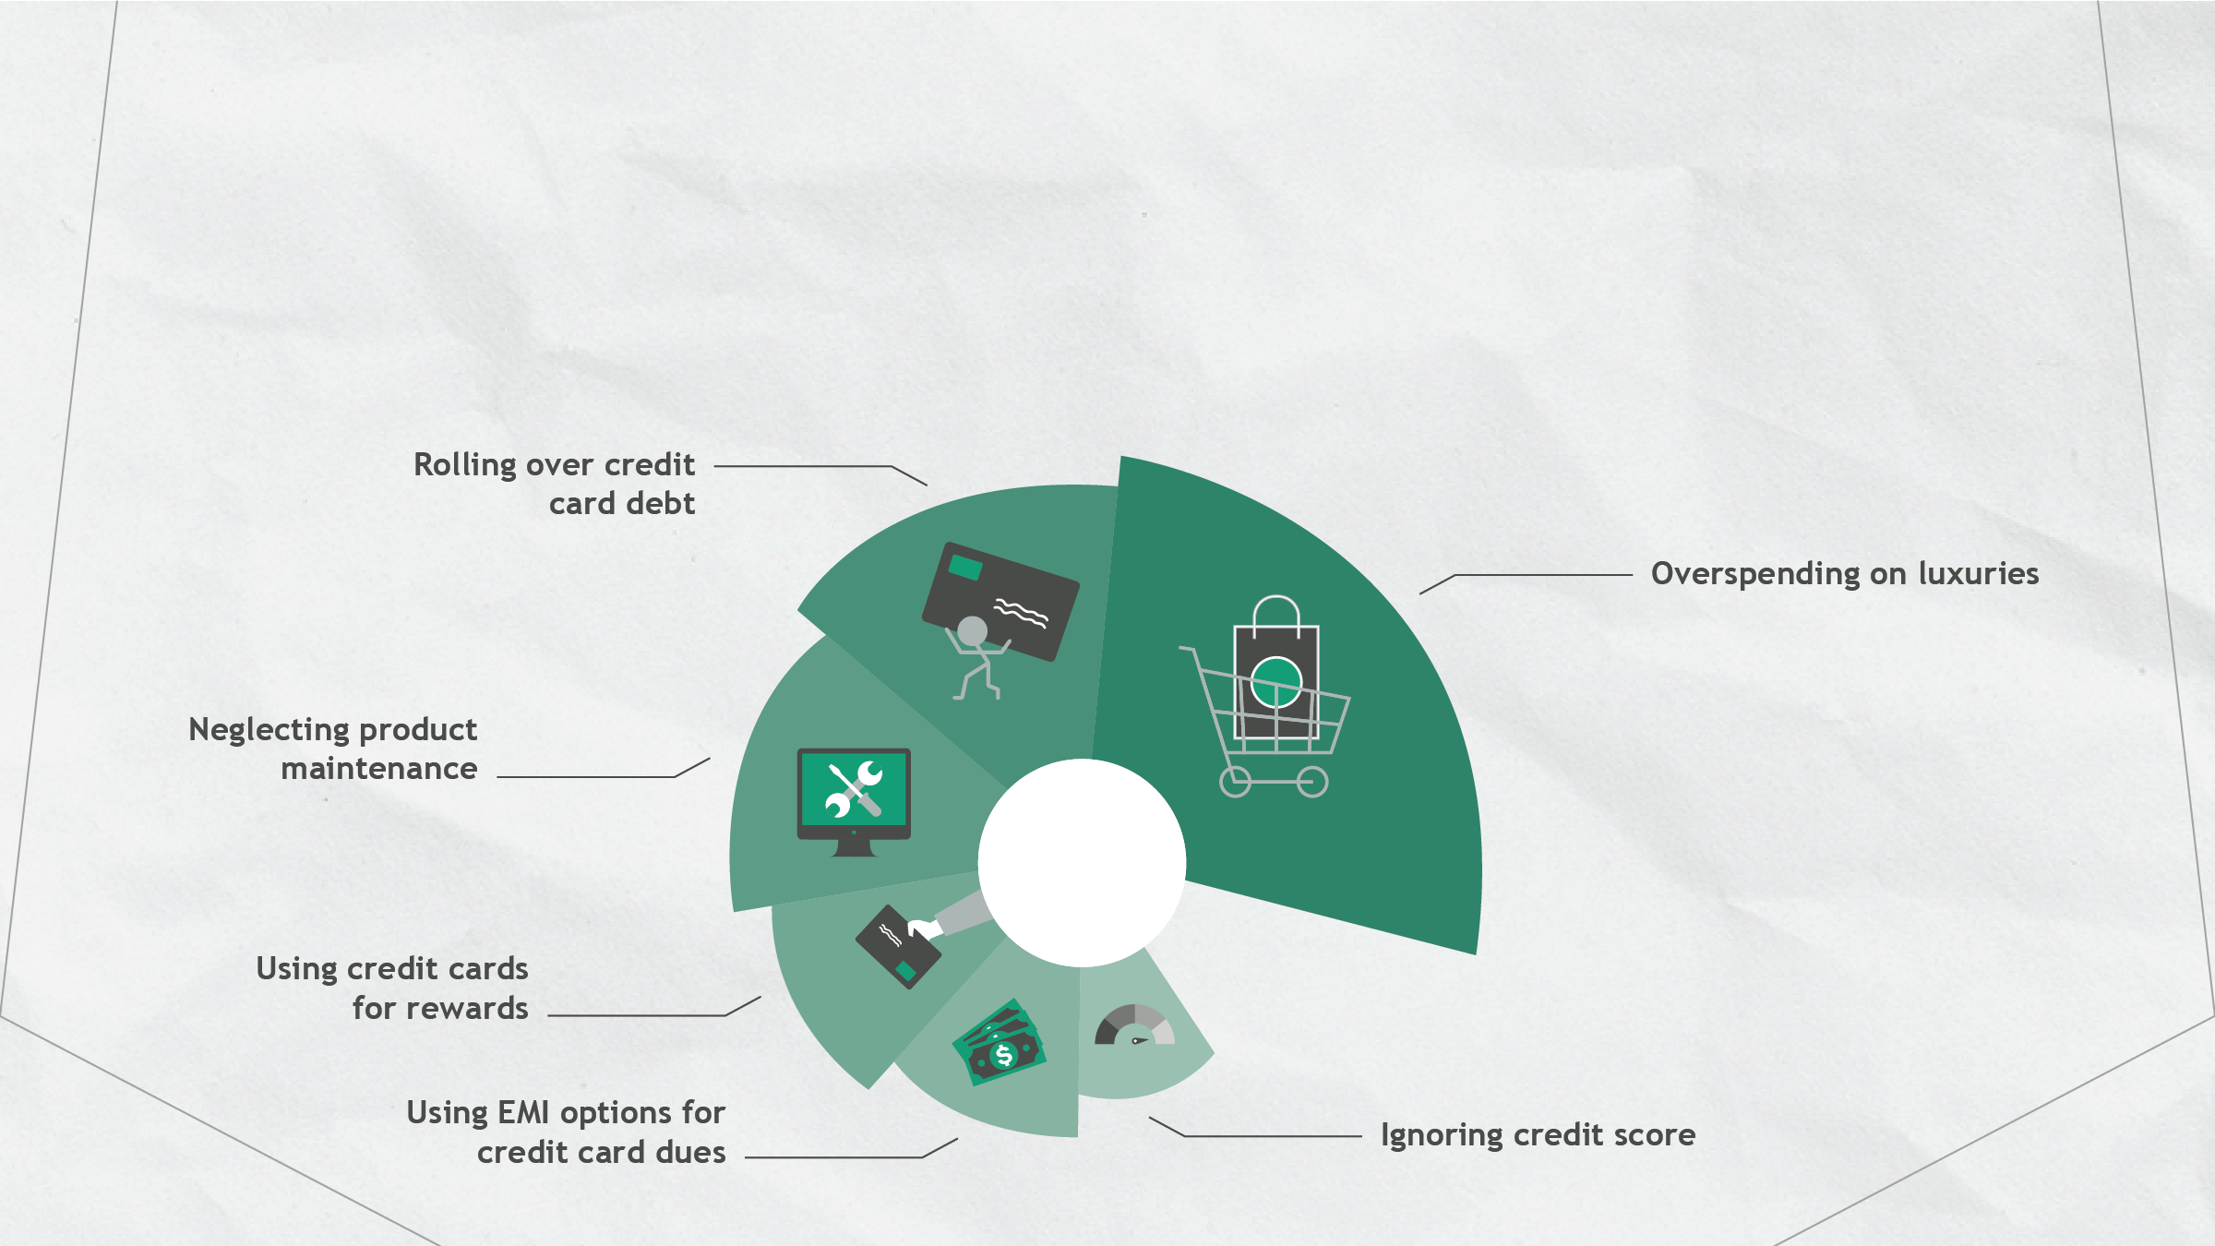
Question #2:
What are the long-term costs to my financial habits?

Slide 8


Question #3:
How much is enough?

Slide 9

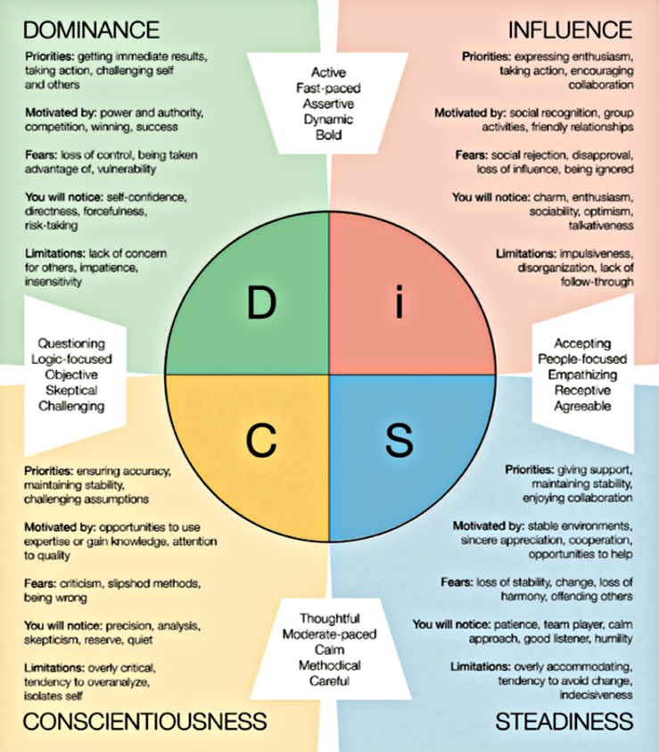
Question #4:
What motivates US to reach OUR financial goals?

Slide 10

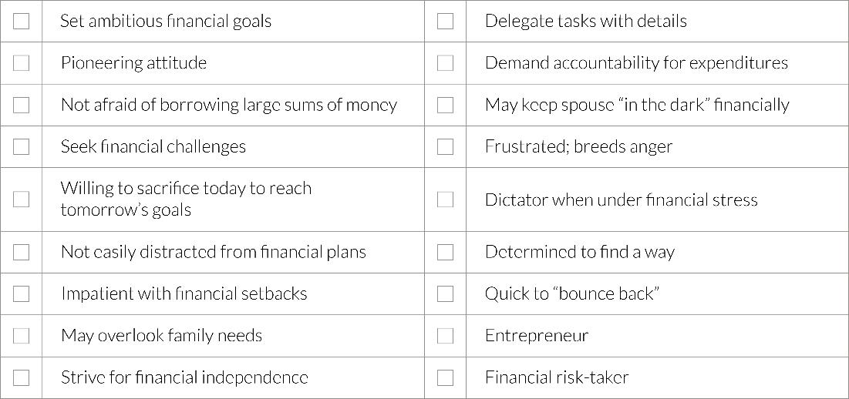
Tendencies for people with high
Dominance

Slide 11
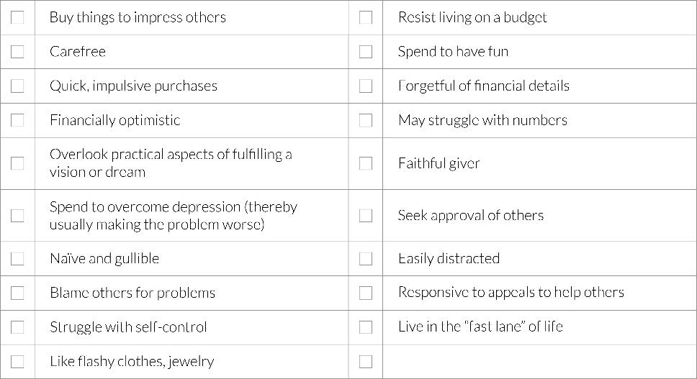
Tendencies for people with high
Influence

Slide 12
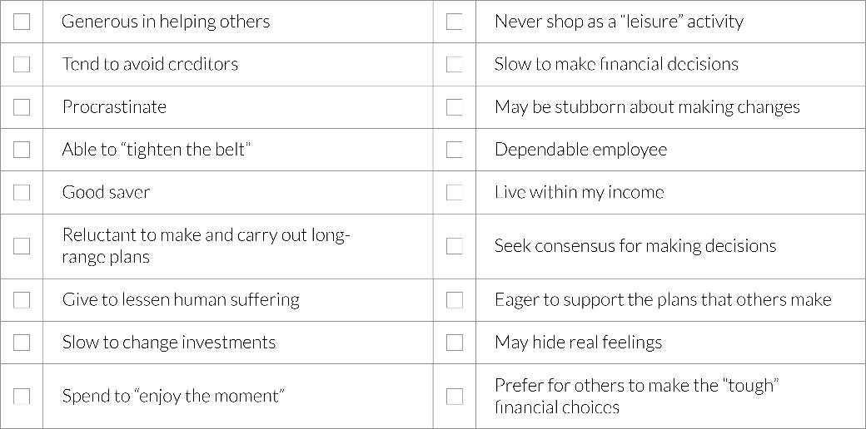
Tendencies for people with high
Steadiness

Slide 13
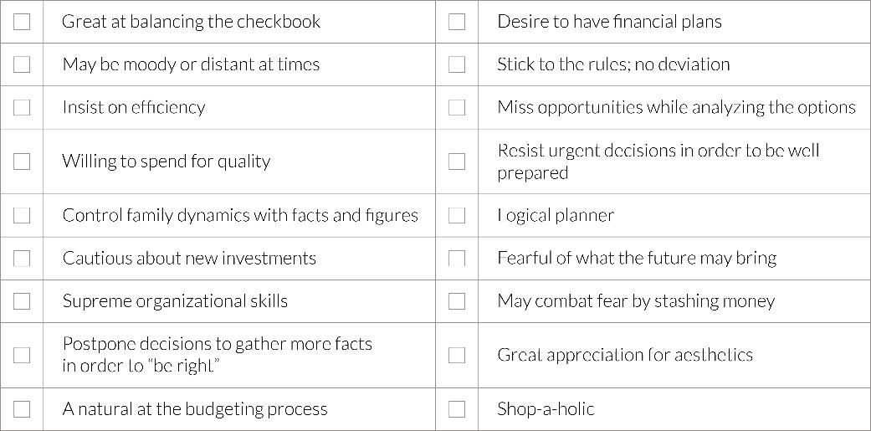
Tendencies for people with high
Conscientiousness

Slide 14
Financial Best
Practices Questions

